Slide 1
Introduction of mathematical models
06/08/2021

Slide 2
All models are wrong, but some are useful

Slide 3
History of bioinformatics -> computational biology (human)
Before the human genome project
Mathematical models + systems biology
(Hypothesis + theoretical models)
The human genome project
Annotation of human genome
(Understanding the role of different genes, protein structures,…)
Post the human genome project
Statistical analysis of context (organ, tissue, disease, cell) specific data
(Understanding to context specific biological characteristics)
New technologies
Microarray
Next generation sequencing
Single cell experiments
…

Slide 4
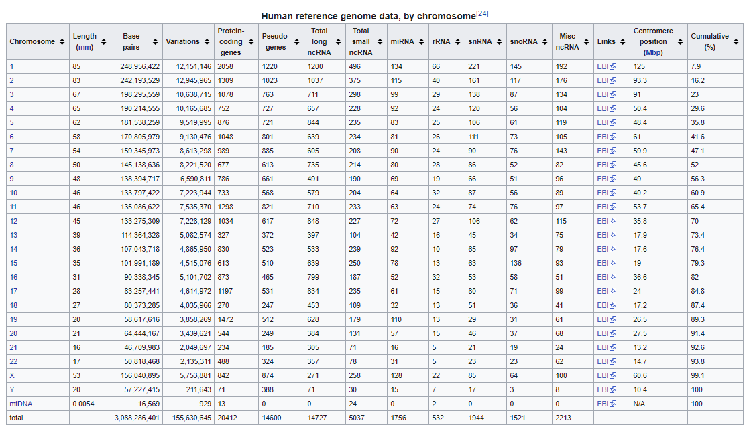

Slide 5
Our further introduction will be in the following aspects
1) Mathematical modeling
2) Biological data (or other data)
3) Biological questions (or other questions)
4) Statistical models
5) programming

Slide 6
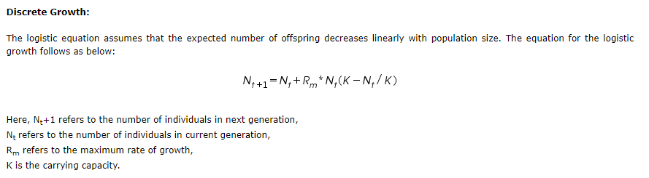
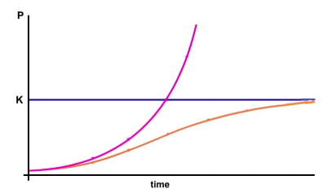
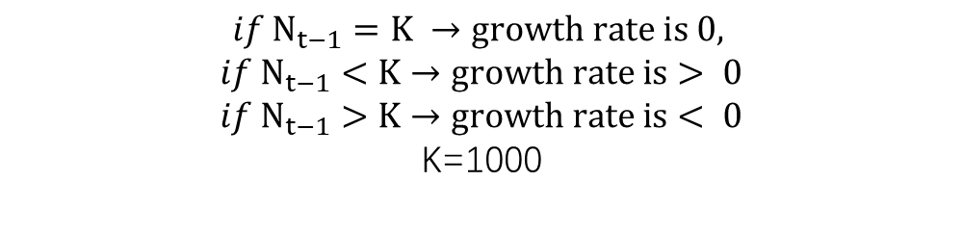

Discrete logistic growth model
$$N_{t}=N_{t−1}+R_{m}∗N_{t −1}(1−\frac{N_{t−1}}{K})$$
$$if N_{t−1}=K →growth rate is 0,$$
$if N_{t−1}<K$ $→growth rate is> 0$
$if N_{t−1}>K$ $→growth rate is< 0$
K=1000

Slide 7
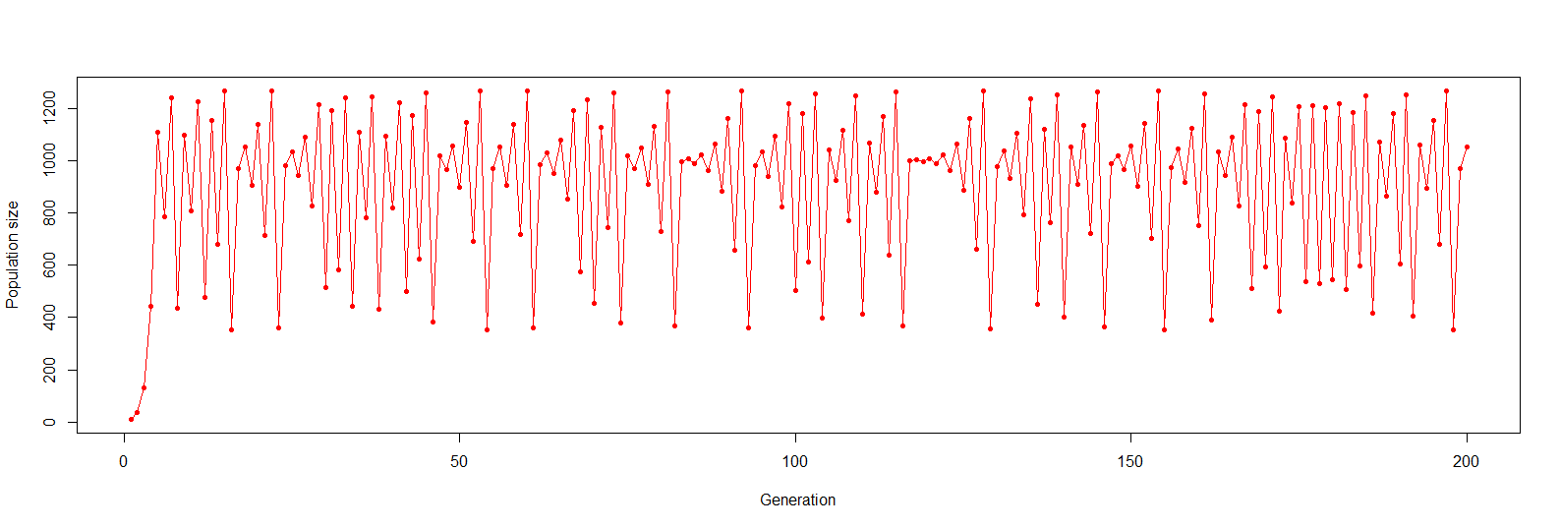
R examples of Discrete logistic growth

